Slide 1

How Does AI Work?
Part 1: Pattern Recognition
© 2020 The Atticus Project

Slide 2



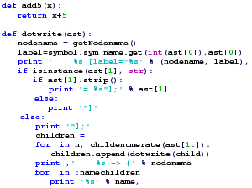
Overview of Steps
Input
Machine Learning Model
Output

Slide 3
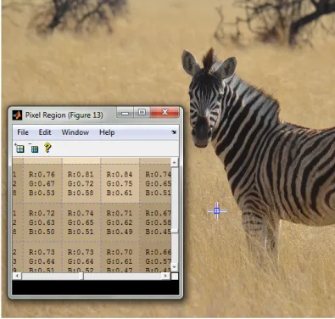
Input
The input is data that has been "pre-processed", or prepared into a format that AI can use, usually by humans using a simple program
Text is converted into a string of characters or words
Images are converted into arrays of pixels
In the picture, pixel colors are converted into three values representing red, green, and blue (RGB).
Source: https://blogs.mathworks.com/steve/2012/12/04/image-effects-part-4/

Slide 4
Machine Learning Model
The model utilizes
Pattern Recognition
to predict and classify data inputs.

Slide 5
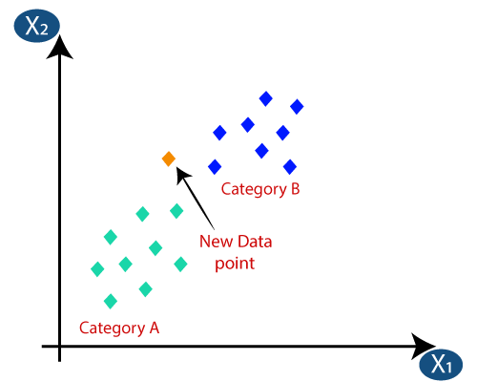
Pattern Recognition
Recognize patterns in data
Group and classify data points based on features
One type of simple pattern recognition is "Nearest Neighbor"
The Nearest Neighbor search looks through the existing data points for the closest one to the new data point.
Use Cases:
Plagiarism detection
Spell-check
Expiration Date
Location in Contract
"Is this date in the contract more close to the text describing an Expiration Date or Effective Date?"
Effective Date
New Date
Effective Date
Distance from context

Slide 6
Pattern Recognition (cont.)
Example: Classification based on contract clauses
Anti-Assignment
An Anti-Assignment clause means the contract can't be assigned without consent or notice.
Change of Control
A Change of Control clause is a type of Anti-Assignment clause where assignment would include a change in control of a contracting party.

